Slide 1

Chapter One:
The Selection of a Research Approach

Slide 2

Table of Contents of Book
Part I: Preliminary Considerations
  1. The Selection of a Research Approach
  2. Review of the Literature
  3. The Use of Theory
  4. Writing Strategies and Ethical Considerations
Part II. Designing Research
  5. The Introduction
  6. The Purpose Statement
  7. Research Questions and Hypotheses
  8. Quantitative Methods
  9. Qualitative Methods
  10. Mixed Methods Procedures

Slide 3
Chapter Outline
The Selection of a Research Approach
The Three Approaches to Research
Three Components Involved in an Approach
Philosophical Worldviews
The Postpositivist Worldview
The Constructivist Worldview
The Transformative Worldview
The Pragmatic Worldview
Research Designs
Quantitative Designs
Qualitative Designs
Mixed Methods Designs
Research Methods
Research Approaches as Worldviews, Designs, and Methods
Criteria for Selecting a Research Approach
The Research Problem and Questions
Personal Experiences
Audience

Slide 4
The Three Approaches to Research
Qualitative
Quantitative
Mixed Methods

Slide 5
The Three Approaches to Research
  Qualitative research:
  Focuses on individual meanings.
  Uses open ended questions.
  Collects data in participant’s setting.
  Uses the an inductive approach to research that moves from particulars to general themes.
  Written report tends to be flexible in structure.
  Quantitative research:
  Tests the relationships among measurable variables.
  Uses closed ended questions.
  Uses survey instruments that produce numbered data.
  Uses statistical analysis of data generated.
  Tests theories deductively, final report is structured.
  Mixed methods research:
  Collects and integrates both quantitative and qualitative data.
  Provides a more complete comprehension of given research problem.

Slide 6
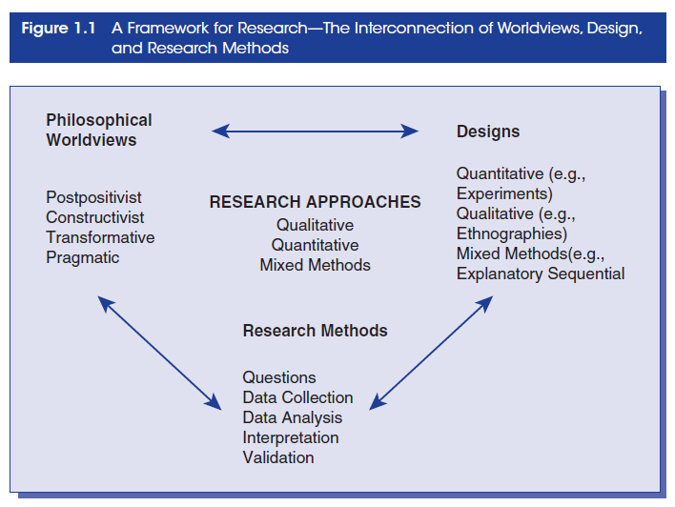
Three Components of a Research Approach

Slide 7
Component #1:
Philosophical Worldview
This is the set of beliefs that guides the Researcher’s actions as they conduct the research.
A Researcher’s philosophical world view may be:
Postpositivism
Constructivism
Transformative
Pragmatism

Slide 8

Four Worldviews for Research

Slide 9
Component #2: Research Design
  Research design is simply the type of inquiry, be it qualitative, quantitative or mixed methods that directs the types of research questions, data collection techniques, data analysis and final report format that the researcher uses.
  Research design should include the following components:
  Plan or proposal to conduct research
  Intersection of:
    Philosophical worldviews
    Strategies of inquiry
    Research methods

Slide 10
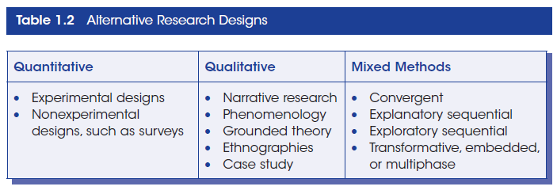
Strategies of Inquiry

Slide 11
Strategies of Inquiry: Quantitative
There are several research designs that are quantitative, these include:
Causal-comparative research
Correlational design
Survey research
Experimental research

Slide 12
Strategies of Inquiry: Qualitative
In this type of research several approaches may be used, these include:
Narrative research
Phenomenological research
Grounded theory
Ethnography
Case studies

Slide 13
Strategies of Inquiry: Mixed Methods
This is an integration of quantitative and qualitative research, data and analyses. It assumes that one type of database or method of analysis may be used to inform and explain another. Some mixed methods include:
Convergent parallel mixed methods
Explanatory sequential mixed methods
Exploratory sequential mixed methods
Transformative mixed methods

Slide 14
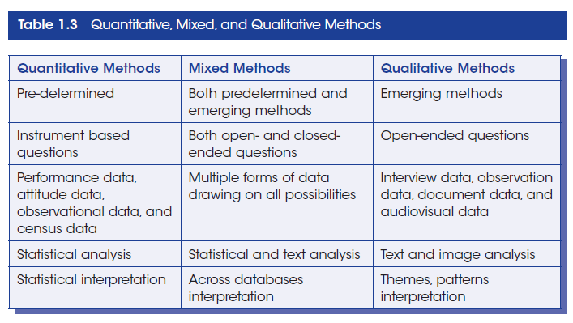
Component #3:
Research Methods

Slide 15
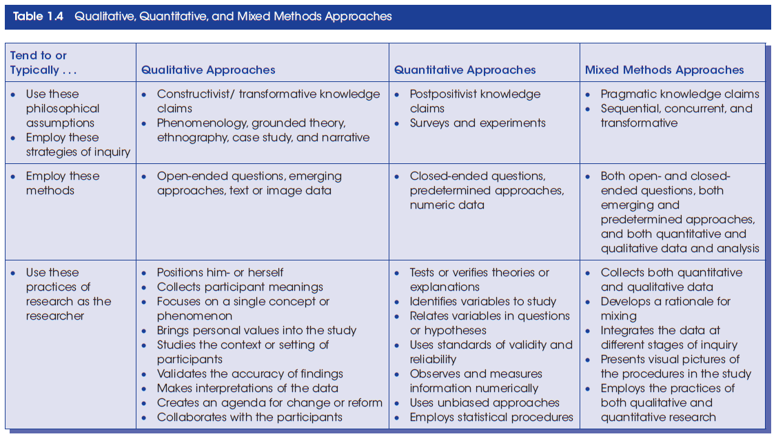
Research Approaches as Worldviews, Design, and Methods

Slide 16
Criteria for Selecting a Research Approach
Chapter 5 power point provides more details on this topic
Research Problem and Questions:
Quantitative approach is best when:
  Testing causal relationships (factor/s that influence a particular outcome).
  Evaluating the usefulness or successes of an intervention.
  Establishing which factors best predict an outcome.
  Testing theories or explanations.
  Qualitative approach is best when:
  The Researcher is uncertain about which are the most important variables to be examined.
  If the topic is new, sample population is unexplored by the topic or the dominant explanations may not apply to a given sample population.

Slide 17
Criteria for Selecting a Research Approach (Cont.)
  Research Problem and Questions Cont.
  Mixed Methods approach is best when:
  Neither quantitative nor qualitative approaches will adequately examine the variables being researched.
  The Researcher wants to capitalize on the strengths of both qualitative and quantitative approaches.
Personal Experiences
  Training
  Preferences
  Time
  Resources
  Experiences
Audience
  Advisors
  Journal editors
  Graduate committees
  Colleagues in the field

